Slide 1
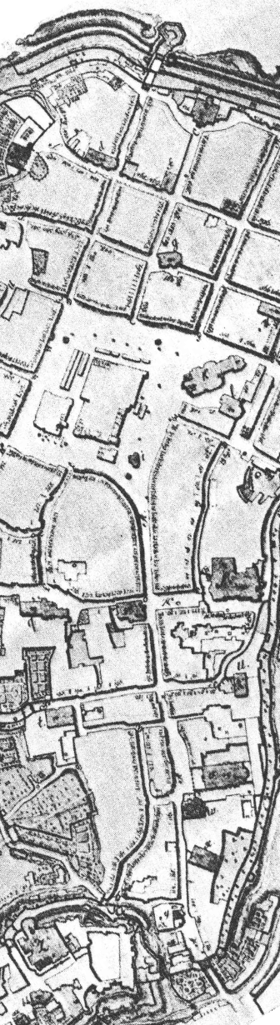
Online 2D/3D graphic interfaces using XML “repurposable” heritage contents
J.Y. Blaise, I. Dudek, A. Durand, P. Bénistant
      ARKIW - PICS 1150 CNRS/KBN*
(*Centre National de la Recherche Scientifique / Komitet Badań Naukowych)
UMR CNRS/MCC 694 MAP / Institut HAIKZ WA PK
UMR CNRS/MCC 694 MAP - Marseilles - F
      APN / ATIP - SHS*
(*Centre National de la Recherche Scientifique, Département Sciences de l ’Homme et de la Société)
UMR CNRS/MCC 694 MAP
Introduction

Slide 2
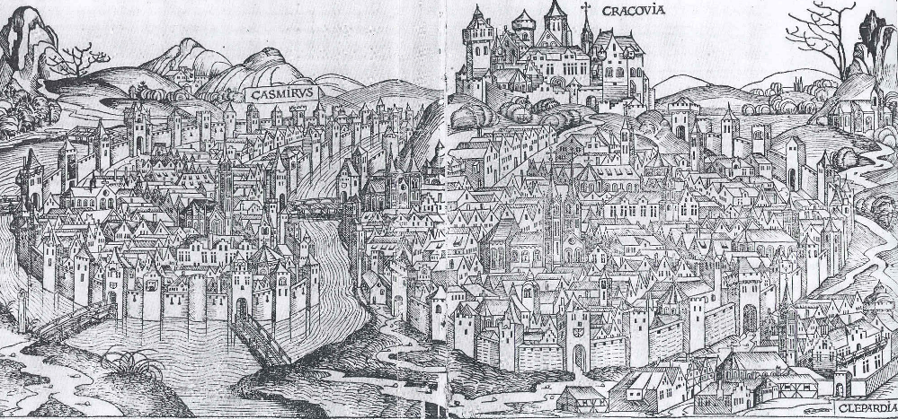
Representation in the study of historical architecture
a way of thinking
a method of communication
UMR CNRS/MCC 694 MAP - Marseilles - F
Introduction
All these representations contain various information about the same object (interpreted or not).
The messages that had to pass were different therefore different modes of representation were used.

Slide 3
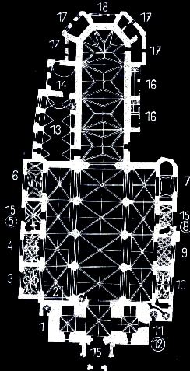
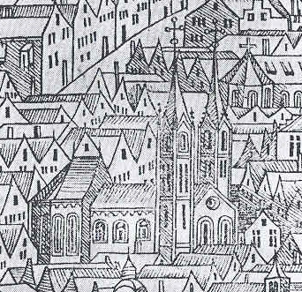
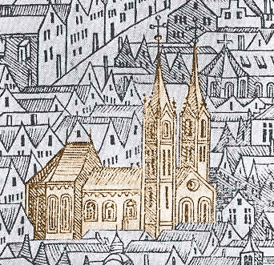
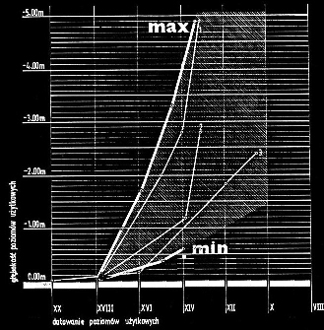
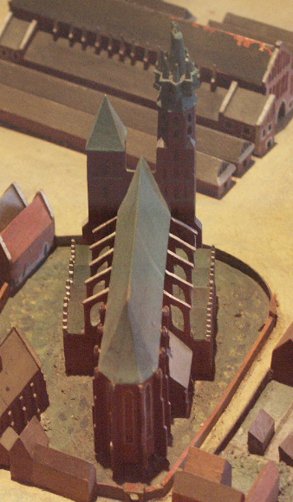
Representation in the study of historical architecture
The type of representation that one uses depends on the information one wants to provide.
UMR CNRS/MCC 694 MAP - Marseilles - F
Introduction
All these representations contain various information about the same object (interpreted or not).
The messages that had to pass were different therefore different modes of representation were used.

Slide 4
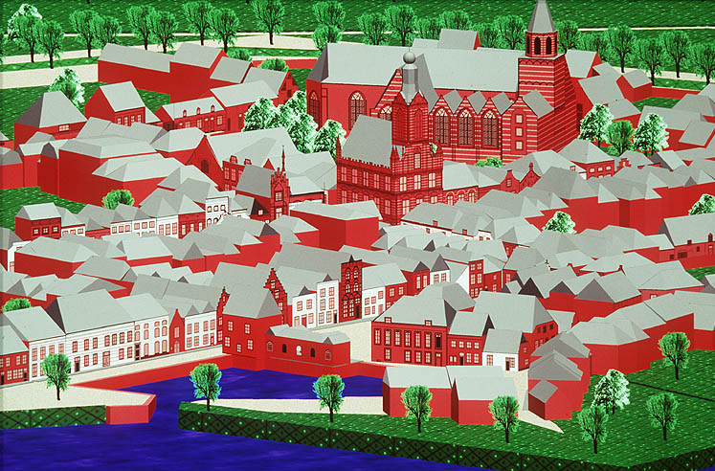
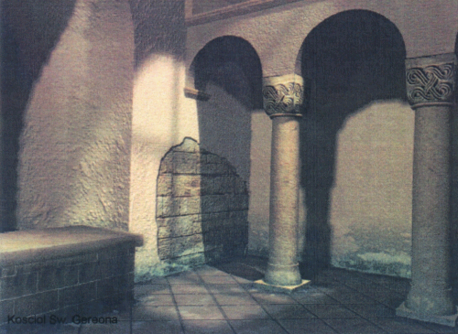
On the use of representation : a mean to an end
1991
The context of the architectural heritage :
  uncertain, inaccurate sources,
  “fuzzy” objects,
  evolutionary knowledge.
Are computer graphics suitable for both communication and reasoning purposes in this context ?
Can they go beyond mimicking real objects?
Can they intervene as a tool for scientific visualisation?
If not, what’s the point?
P.Alkhoven
Information
More technology
less understanding
UMR CNRS/MCC 694 MAP - Marseilles - F
Introduction
2001
MM Multimedia
conjecture

Slide 5
Discussion content
- The project’s statements and hypothesis
  - Documentation problem
  - Link between 3D models and data sets
- Interpretative visualisation
- Implementation
- Examples of representation
- Conclusion
UMR CNRS/MCC 694 MAP - Marseilles - F
Content

Slide 6
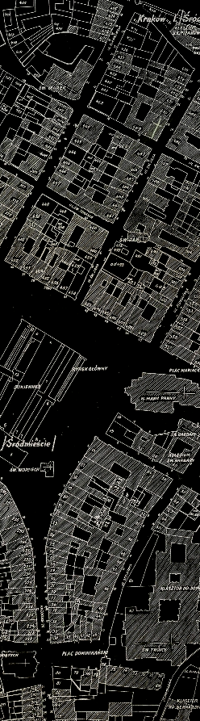
Documentation is our concern.
observation >
  In the field of heritage, a wide proportion of the knowledge is based on documentation and its analysis.
documentation >
  all the types of materials related to an object
  photography, survey, cartography, expertise, archival texts, …
  raw data, interpreted data
Initial statement and hypothesis
UMR CNRS/MCC 694 MAP - Marseilles - F

Slide 7
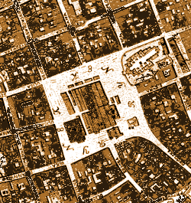
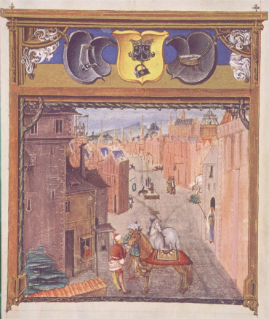
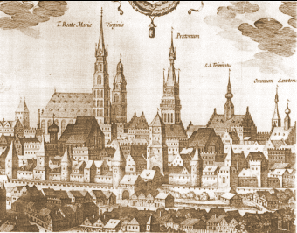
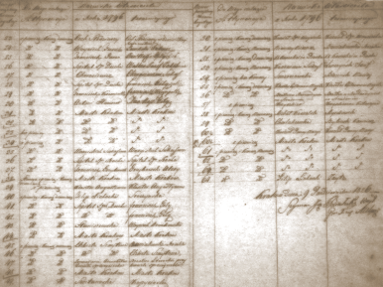
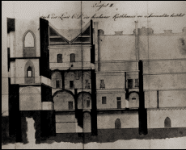
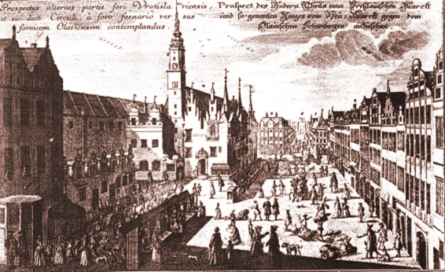
Documentation is our concern.
- An example of the documentation’s variety : raw data
about Ratusz Krakowski, the old town hall.
Initial statement and hypothesis
UMR CNRS/MCC 694 MAP - Marseilles - F
analogie
analogie

Slide 8
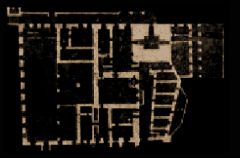
Documentation is our concern.
The more we step back in time > documentation is less precise
        > documentation is less numerous
données
t
Initial statement and hypothesis
UMR CNRS/MCC 694 MAP - Marseilles - F

Slide 9
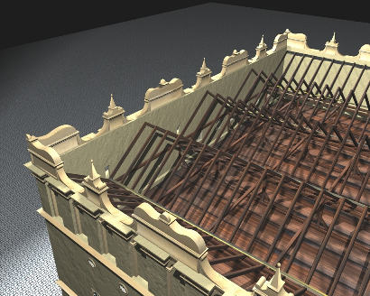
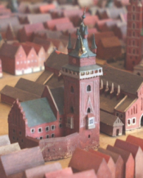
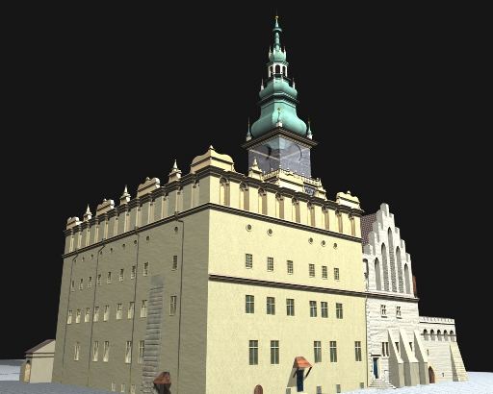
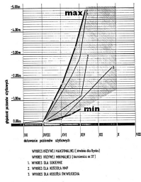
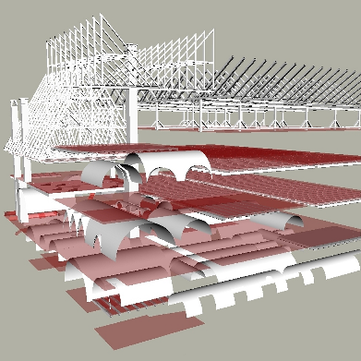
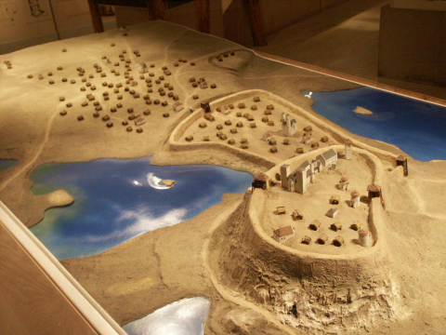
Documentation is our concern.
- A step of interpretation
Initial statement and hypothesis
UMR CNRS/MCC 694 MAP - Marseilles - F

Slide 10
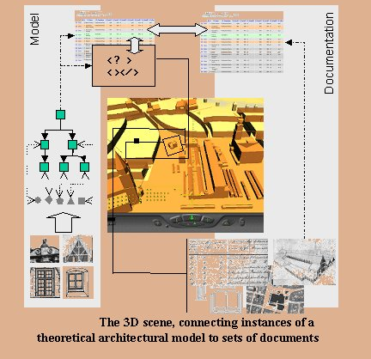
Information system for architectural conservation
  theoretical model,
  data analysis
  (information on the data content)
  data description
  (author, localisation ,etc..)
  dynamic representations
Initial statement and hypothesis
UMR CNRS/MCC 694 MAP - Marseilles - F

Slide 11
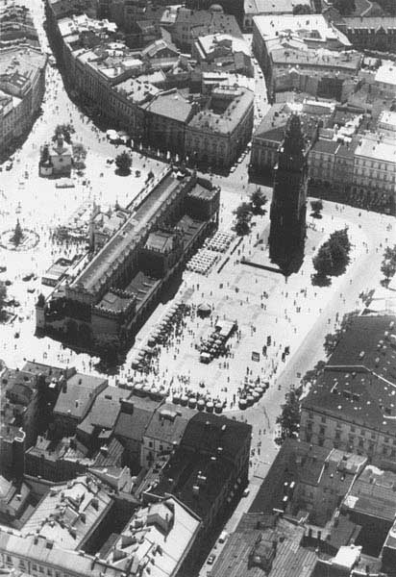
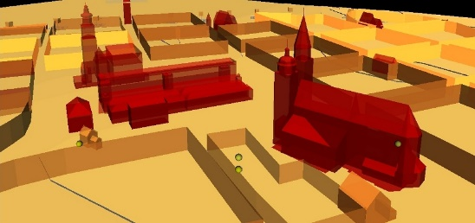
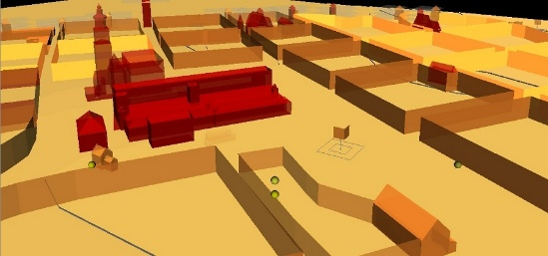
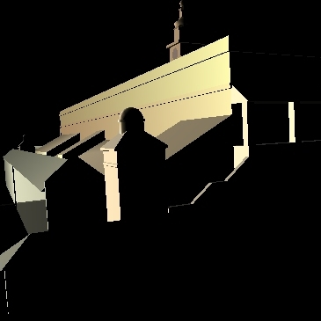
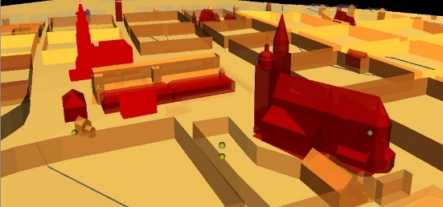
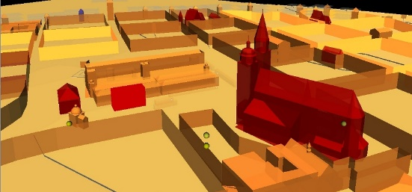
Interpretative visualisation
symbolic representation
(we show only what is essential in a particular context)
t
UMR CNRS/MCC 694 MAP - Marseilles - F
Interpretative visualisation

Slide 12
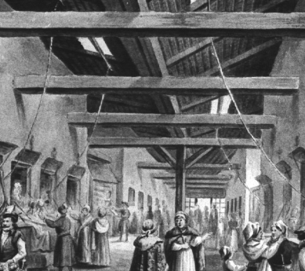
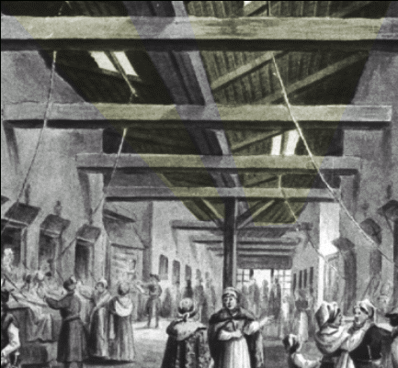
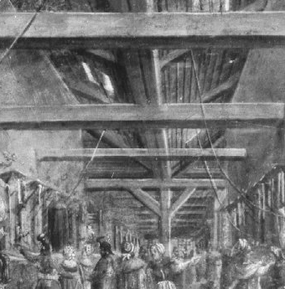
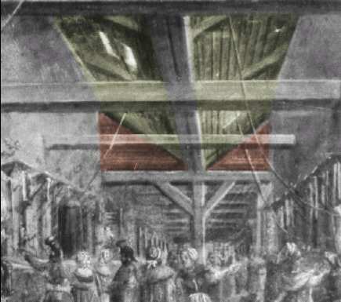
Data uncertainty
semantic graphic codes
(underline inconsistency in the documentation or its analysis)
Edifices that we study have been widely transformed throughout the centuries if they have not been totally destroyed.
- Visualise shapes that in all cases are hypothetical
  - Propose visual markings of the object represented
  in a 3D scene that correspond to the hypothesis’
  evaluation.
UMR CNRS/MCC 694 MAP - Marseilles - F
Interpretative visualisation

Slide 13

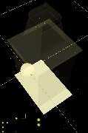
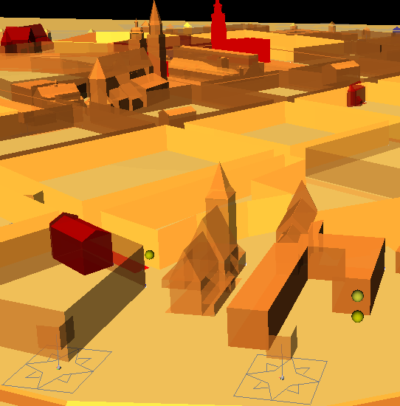
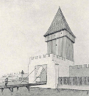


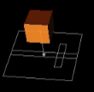
Undocumented objects and object with unknown morphology
    semantic graphic codes
    (to indicate the level of incompleteness concerning the investigation)
The solution we propose is to
stress the lack of information
by a visual sign in the 3D scene.
M o r p h o l o g y
S o l u t i o n :
Object has been instanced without references
particular level of transparency
documentation
?
UMR CNRS/MCC 694 MAP - Marseilles - F
Interpretative visualisation
undocumented object
?
Object instanced and documented but its morphology is undefined
library of 3D graphical signs
documentation
morphology undefined

Slide 14
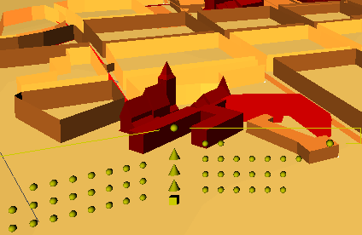
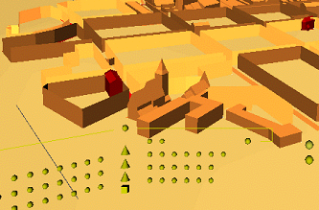
Knowledge evolutions
semantic graphic codes
(to provide an updated visualisation of our knowledge on an object)
3D scenes show what we know,
as well as they represent what we ignore: concepts are given an appearance stemming from our
current state of knowledge.
UMR CNRS/MCC 694 MAP - Marseilles - F
Information better defined
Interpretative visualisation
New
information

Slide 15
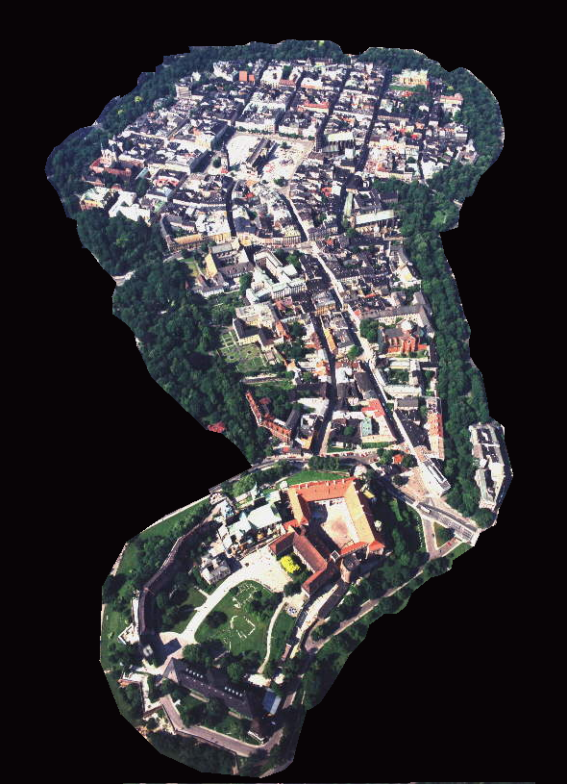
Field of experimentation : historic centre of Kraków
The layout of the old town is the result
of successive additions and of the
evolution of various urban structures :
- ensemble of the Wawel Hill
- the suburbium called Okół
- the medieval town located in 1257.
Field of experimentation
UMR CNRS/MCC 694 MAP - Marseilles - F

Slide 16
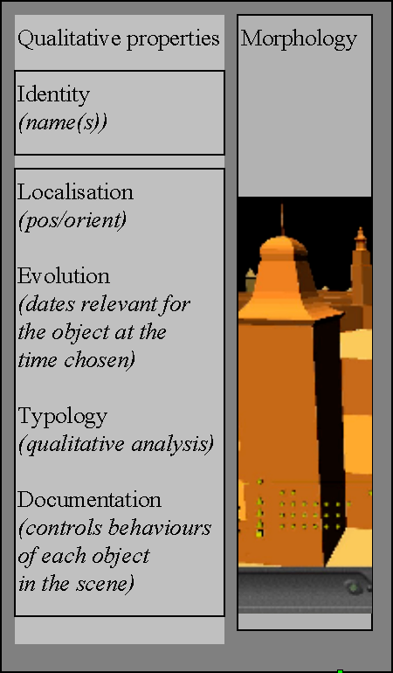
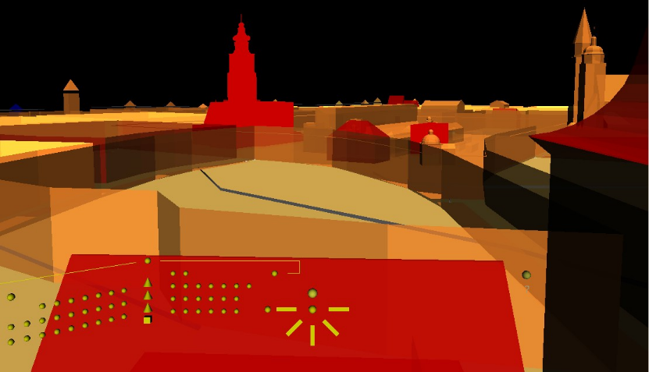




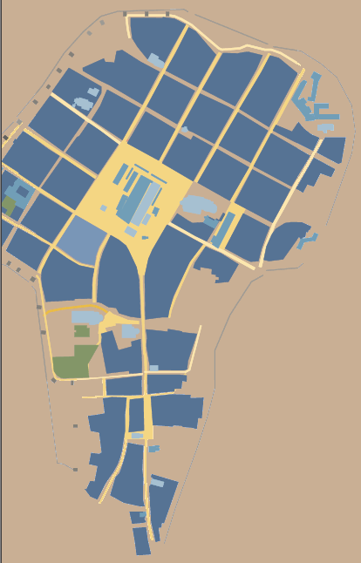
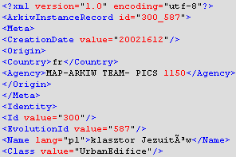




Evolutions of the object and justifications
URLs
Implementation
SGBD / RDBMS
Instances
Documentation
Implementation
UMR CNRS/MCC 694 MAP - Marseilles - F
Model
set of concepts
(classes)
XML
Morphology
Vocabulary

Slide 17
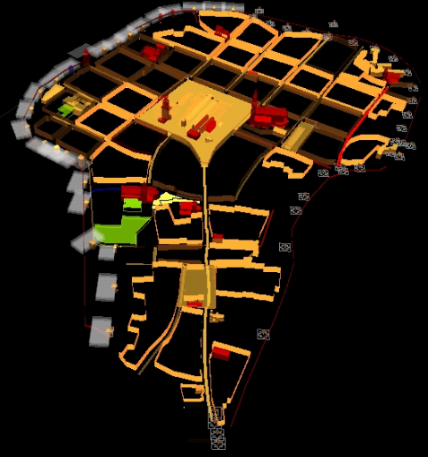
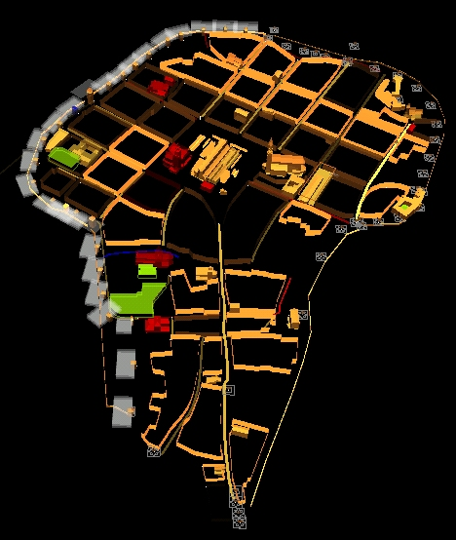
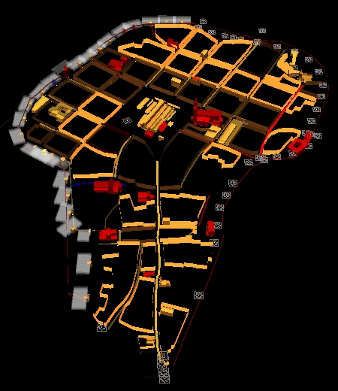
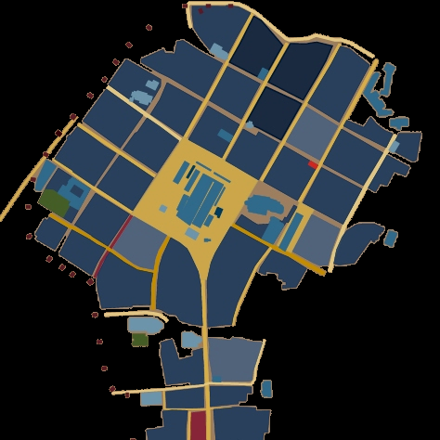
3D models created dynamically
query :
Urban Block
Urban Edifice
Street
Square
Green Area
Fortifications
...
UMR CNRS/MCC 694 MAP - Marseilles - F
1550
1646
1751
1894
year
Example

Slide 18
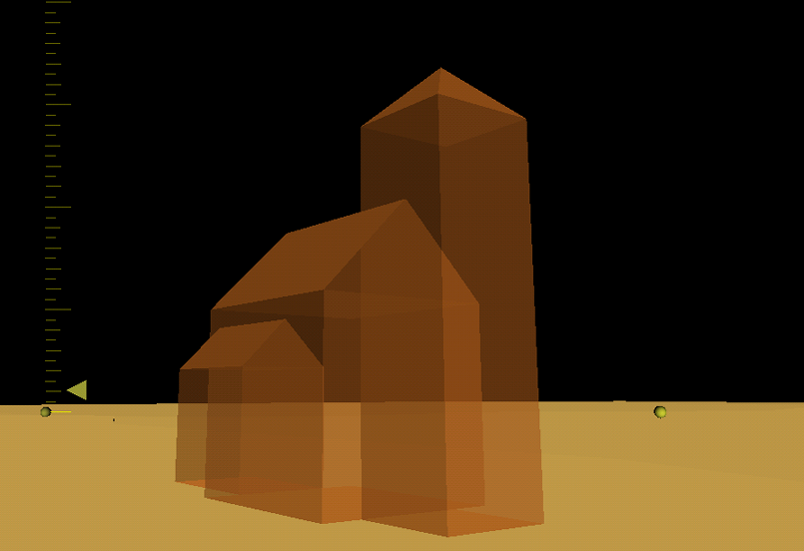
Timeline scenes
St. Adalbert church
UMR CNRS/MCC 694 MAP - Marseilles - F
Example
999-1000

Slide 19

Timeline scenes
St. Adalbert church
UMR CNRS/MCC 694 MAP - Marseilles - F
Example
1100-1110

Slide 20

Timeline scenes
St. Adalbert church
1611-1618
UMR CNRS/MCC 694 MAP - Marseilles - F
Example

Slide 21

Timeline scenes
St. Adalbert church
1711
UMR CNRS/MCC 694 MAP - Marseilles - F
Example

Slide 22

Timeline scenes
St. Adalbert church
1778
UMR CNRS/MCC 694 MAP - Marseilles - F
Example

Slide 23

Timeline scenes
St. Adalbert church
1860-1863
UMR CNRS/MCC 694 MAP - Marseilles - F
Example

Slide 24

Timeline scenes
1957-1967
St. Adalbert church
UMR CNRS/MCC 694 MAP - Marseilles - F
Example

Slide 25













Handling architectural evolutions - St. Adalbert church
UMR CNRS/MCC 694 MAP - Marseilles - F
Example

Slide 26


3D scene - documentary sources
Translucency : marks absence
of documentation or its evaluation
Emissive colouring: marks objects
that are documented but not justified
Symbolic shapes : visualise presence of
an object that has not been given
morphological properties.
Appearance Selector:
Cones controls the level of translucency of objects ,
Spheres control the highlighting of objects
Anchor Selector:
controls which resource will be
queried when an object is clicked
UMR CNRS/MCC 694 MAP - Marseilles - F
Red/Blue colouring: States
whether the morphology
relates to the scene’s date
Example
If the scene reflects the documentary sources, it requires graphical marking of the information available on objects.
The scenes are computed at the time of the query
Highlighting : visualises
presence of a document
type for the object (each
sphere corresponds to a
given type of document)

Slide 27





Visualisation of a document’s “corresponding edifices”
UMR CNRS/MCC 694 MAP - Marseilles - F
Example

Slide 28

Conclusion
Possible benefits of our approach:
- A central improvement in the actual practice : architectural data finds its natural media, shapes,
- On the documentation side, the possibility given to visualise what a particular document is about (edifices quoted)
- The possibility to compare levels of information between various sectors or objects types inside the territory observed.
3D models : sustainable investigation
and visualisation tools if reaching
the readability of a geographical map.
UMR CNRS/MCC 694 MAP - Marseilles - F
Conclusion

